Slide 1

Department of Computer Science & Engineering Knowledge Management Case Study

Slide 2
Team:
Name | SRN
Amogh Rajesh Desai | PES1201700180
Vivek Aditya | PES1201701125
Pratyush Mishra | PES1201700126
Varsha C | PES1201701387
Saransh Gupta | PES1201700267
Achintya Shivam | PES1201700151

Slide 3
About Whirlpool
Whirlpool Corporation has grown from its origins as a Midwestern
U.S. company to the major appliance industry’s global leader
90,000+ employees
Manufacturing in North and South America, Europe, Asia and Africa
Nine brands, ﬁve and over $1 billion in sales
Leads the $120 billion global home appliance industry with 2013 sales of about $19 billion
Products sold in over 130 countries around the world
Manufacture appliances across all major categories including fabric care, cooking, refrigeration and dishwashers, water-filtration , counter-top organization.

Slide 4
Whirlpool’s Achievements
It was ten years ago, that Whirlpool shifted from engineer-driven company to customer-focused company and way to achieve that was through innovation.
In 2011 US-based home appliance major Whirlpool Corporation(Whirlpool) was ranked #6 “World’s 10 Most Innovative Products Companies list “ released by Fast Company. This was the second consecutive year Whirlpool was named to the list.
Despite economic recession, Whirlpool generated more than US$3.6 billion in revenue from its innovation efforts in 2010.

Slide 5
How did company come up with idea of innovation
In 1997, Whirlpool rolled out a brand focused value creation strategy which focused on building brand equity and customer loyalty by developing path breaking products.
Whitwam, the CEO of the company at that time felt that in order to execute its brand focused value creation strategy, Whirlpool would have to be innovative and operationally excellent.
However, the company was unable to create sufficient value for its shareholders, though it was leading global home appliance maker at that time.

Slide 6
Knowledge Management in the Company
In 1999, the then CEO of Whirlpool, David R. Whitwam, launched a worldwide effort to embed innovation as a core competency across the organization.
Whirlpool was recognized as an innovation leader for embedding innovation across the company and for launching breakthrough products that satisfied unmet consumer needs.
The key objective of Whirlpool's innovation strategy was to help every single employee think outside the box and come up with exciting products that delivered real value to consumers and generated revenues for the company.
As innovation from everyone and everywhere required knowledge to be assimilated and democratized, the company set up a comprehensive internal Knowledge Management System (KMS) in 2001.

Slide 7
KM objectives of the company
Company’s new vision : “Innovation from Everyone and Everywhere” which meant innovation across the company including its products , customers touch points , business systems with suppliers and vendors , and its entire strategic focus.
Key objective was to derive innovative ideas not just from a central product development team but from everywhere and everyone.
New vision was supported by three new prerequisites –
Reach High , Focus on What Matters , Do What You Commit To.

Slide 8
Need for KM system?
One of the major challenges that the whirlpool corporation encounters in the market is innovation resistance. Due to the long-term nature of innovation, consumers are less interested in new products or improvements mainly because it is an interruption to already existing established routines. Consumers get used to a particular product and it becomes a problem to convince them to change to a different outﬁt altogether.
Another challenge that the corporation have been dealing with is the issue of quality and efﬁciency. Whirlpool products have had its share of consumer complaints with regard to the standard of performance.

Slide 9
How did they start?
Whirlpool created new processes for product development, personnel evaluation, knowledge management, financial accounting, resource allocation and project reviews.
The founder mandated that Whirlpool's business units and regional offices spend a certain amount on supporting new concept development, corporate set-aside of a fixed percentage of the capital expenditure budget for innovation projects.
Mid-stage funding for innovation or corporate entrepreneurship projects was controlled primarily by new oversight and review bodies known as I-boards consisting of business leaders, senior executives, or brand teams.

Slide 10
Set Backs - I
Understand the strategic importance of knowledge management in gaining a competitive advantage
Analyze the knowledge management tools used by Whirlpool to capture and disseminate knowledge
Understand the issues and challenges faced by a company in deploying innovation as a core competency

Slide 11
Set Backs - II
Examine the role played by the top management to develop a knowledge management framework in an organization
Explore strategies that the company might adopt in the future to drive innovation and encourage knowledge sharing
The scale of technology that must be used to match the requirement
Appreciate the use of IT for knowledge management and innovation management
The scalability was on the minds of the system developers

Slide 12
Knowledge management at Whirlpool
To embed innovation in everyone and everywhere, Whirlpool required a KMS that would democratize knowledge and information and allow people to learn about innovation.
For this purpose, Whirlpool decided to build a comprehensive internal KMS that would provide the company with a platform to store and share ideas as well as help change the culture to one that was inclusive about its knowledge.
Main Approaches are:
I-PIPE
Innovation E-Space

Slide 13
I-PIPE
As part of its KMS, Whirlpool adapted a tracking system called the Innovation Pipeline (I-Pipe) from Strategos and placed it on the company's intranet with a little modification.
The I-Pipe was a dashboard view of the innovation pipeline at Whirlpool which tracked ideas from concept to scale-up.
Initially, the I-Pipe was used by innovation teams. Later, the system was opened to every employee within the company who could access it through the employee intranet portal.
Through the I-Pipe, employees could view ideas or any single innovation by product category or region, contribute to them, or add to an existing idea

Slide 14
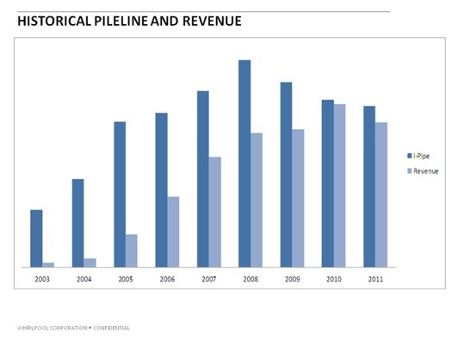
Growth of I-pipeline and revenue

Slide 15
Innovation E-Space
Whirlpool realized that it needed to create a technical platform to engage the entire Whirlpool population in the innovation embedment effort.
The company wanted to set up an efficient IT infrastructure where employees could provide suggestions and ideas, obtain feedback, and volunteer for innovation projects.
The result was Innovation E-space, an intranet-based KM website that allowed all employees to keep track of innovation activities at the company. Innovation E-Space was open to anyone at Whirlpool who had access to the intranet.
According to the company, Innovation E-Space was a self-help and exploration system to help innovators get started and gain in-depth knowledge about the customer.

Slide 16
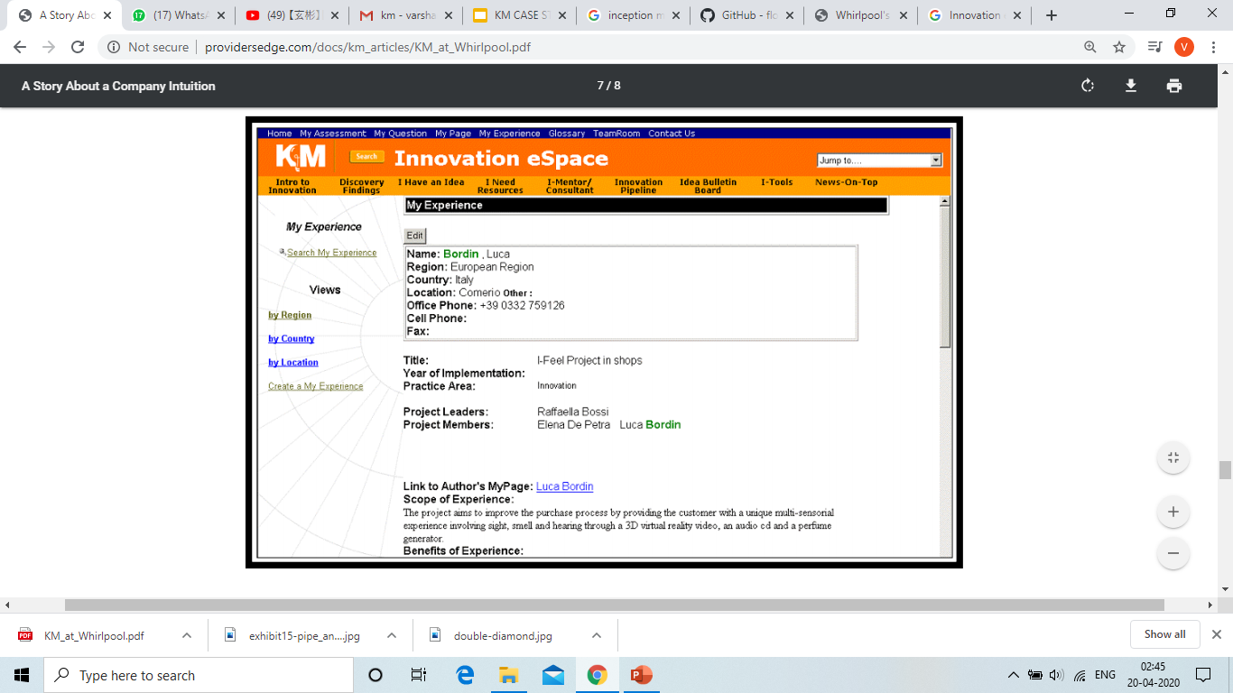
Innovation e-space

Slide 17
Consumer-Driven Innovation Model
Whirlpool developed its ‘consumer-driven innovation model’ that recognized three areas for innovation – new products, marketable innovations and product replacements .
It was reported that the innovation model encouraged employees to understand customer needs and get more involved in product development and designed “Double Diamond innovation process” .
In this process, products were designed by looking at various perspectives such as company values, customer views, understanding the processes and environmental issues.

Slide 18
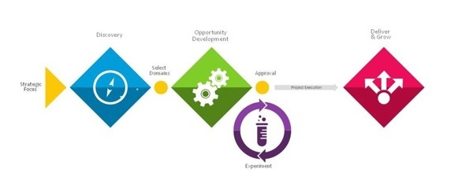
Phases In Double-Diamond Innovation Process
Ideas , Business case , Prototype and Setup

Slide 19
About i-box tool
This tool was used to make people understand about innovation.
Through the use of this tool, teams around the world measure their projects against the innovation definition and put innovations at test.
Through its practice and this common language, they have the right conversations and challenge themselves in areas that would improve the “innovativeness” of a project.

Slide 20
Results
The KMS at Whirlpool contributed to innovation embedment and competency development.
According to industry experts, Whirlpool had differentiated itself in innovation by creating a sustainable innovation model and by embedding it across the organization.
The outcome of the KMS was a stream of breakthrough ideas for products which came from all over the Whirlpool organization and delivered value to consumers.
In a stagnating industry where many of Whirlpool's rivals were struggling to survive, Whirlpool’s overall revenues and profits were growing at a steady rate.
Based on innovation in both products and processes, Whirlpool became a market leader in the global appliances industry, said experts.

Slide 21
Outlook
Over the years, Whirlpool had become a model for the embedment of innovation as a core competence across the entire organization.
As of 2011, Whirlpool's branded consumer product businesses represented approximately 22% of the company's annual revenues. Full-year 2011 sales reached US$18.7 billion.
"As we enter 2012, we are executing strong actions to continue to improve operating margins through our cost and capacity reduction initiatives, ongoing productivity programs, and previously announced price increases.

Slide 22
THANK YOU!

